Slide 1



PORTS AND CONNECTORS
GROUP 5

Slide 2




Radha
Aaron
our team
Arif
Betty

Slide 3



definition and purpose
Ports
Socket for conncting external devices to the sytem unit
Ports connect directly to the system board and to cards inserted into slots on the sytem board.
Connectors:
the plugs or ends of a cable that go into the ports.

Slide 4
purpose
Enable communication between devices.
Facilitate data transfer, charging, audio/video output, and internet connectivity.
Help in expanding device functionality (e.g., plugging in USB drives, printers, external displays).

Slide 5

Types of ports
Port Type | Full Name | Function | Example Device
USB | Universal Serial Bus | Transfers data, connects peripherals, charging | Keyboard, mouse, flash drive
HDMI | High-Definition Multimedia Interface | Sends high-quality audio/video | Connect PC to monitor/TV
VGA | Video Graphics Array | Transmits analog video | Old monitors or projectors
Ethernet (RJ-45) | - | Wired internet connection | LAN cables to routers
Audio Jack (3.5mm) | - | Transfers audio signals | Headphones, speakers
DisplayPort | - | Digital video/audio | Modern monitors
Thunderbolt/USB-C | - | High-speed data, video, power | Laptops, phones, docking stations

Slide 6
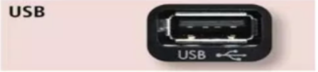
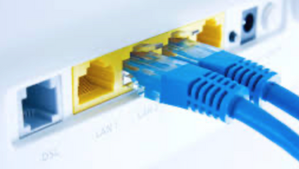

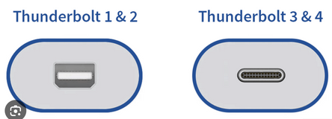
STANDARD & SPECIALIZED PORTS
USB
Keyboards, mice, printers, storage devices
Ethernet
High speed networking
HDMI – High Definition Multimedia Interface
- High definition video and audio
Thunderbolt
-Provides high-speed connections
-Can connect up to 7 separate devices through 1 port
STANDARD PORT

Slide 7
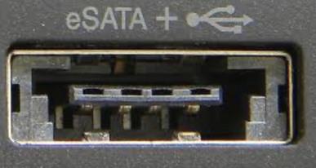
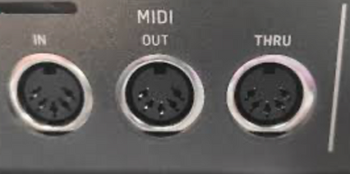
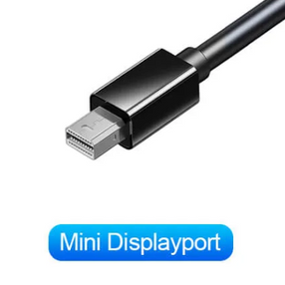
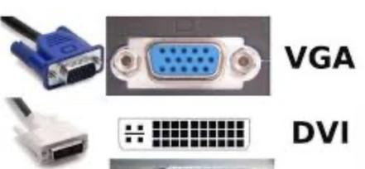
STANDARD & SPECIALIZED PORTS
External Serial Advanced Technology Attachment (eSATA)
High-speed connection for external secondary storage
Musical Instrument Digital Interface (MIDI)
Connect musical instruments
Mini DisplayPort (MiniDP or mDP)
Connection to large monitors
VGA & DVI
Connections to analog and digital monitors
FireWire
High-speed connections to FireWire devices
SPECIALIZED PORT

Slide 8



How Different Ports Are Used in Hardware Connections
Use Case | Port | Connector Example | Description
Connecting a keyboard | USB-A | USB connector | Plug into USB port for typing
Internet (wired) | Ethernet | RJ-45 connector | Connects PC to router/modem
Display to monitor | HDMI | HDMI cable | Transmits video & audio
Projector (old models) | VGA | VGA cable | Analog video output
Phone charging | USB-C | USB-C cable | Power and data sync
Headphones | 3.5mm jack | Audio plug | For audio output

Slide 9

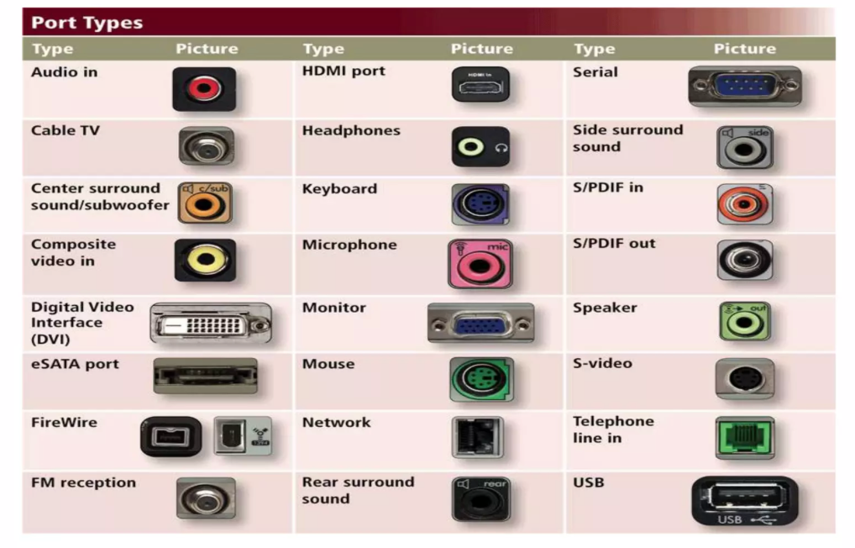

Slide 10
examples of real world usage
Laptop to TV:
Port: HDMI
Use: Watch movies from your laptop on a bigger screen.
PC to Router:
Port: Ethernet (RJ-45)
Use: Faster and stable internet than Wi-Fi.
USB Flash Drive:
Port: USB-A/USB-C
Use: Transfer files between devices.
Printer Connection:
Port: USB
Use: Print documents from computer
Headphones:
Port: 3.5mm Audio Jack
Use: Listen to audio privately.

Slide 11
Q & A
HDMI ports are used only for video output?

Slide 12
thank you
Presented by
Group 5

